Slide 1


Technical Overview

Slide 2









Company Snapshot
HEADQUARTERS
St. Louis, MO
FOUNDED
January 2, 2017
TEAM MEMBERS
185
PRODUCT CATEGORIES | Conversational AI, Digital Engagement, Support Automation
USE CASES | Customer + Employee Engagement
INTELLECTUAL PROPERTY | 14 granted US Patents + numerous trademarks
SECURITY + COMPLIANCE | SOC 2 Type II, GDPR, HIPAA, FERPA, CCPA
CUSTOMERS | 2,300+ customers spanning Enterprise, Mid-Market and SMB
CONFIDENTIAL © 2024 AI SOFTWARE, LLC

Slide 3


















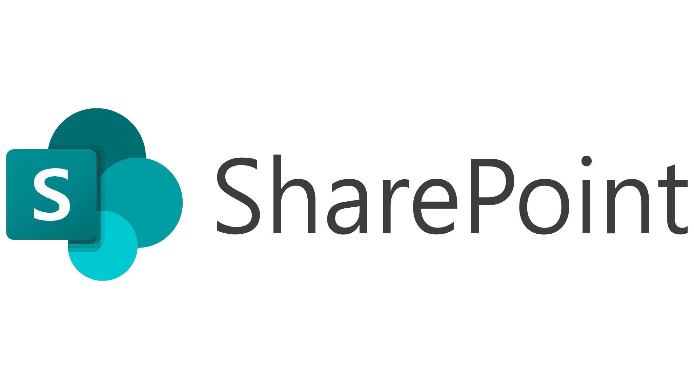




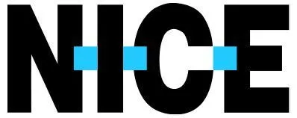





About Capacity
BIGGEST KEY DIFFERENTIATOR
AI-first platform that drives down support costs with +90% self-service deflection rate.
COMMON PHRASES TO DESCRIBE CAPACITY
Support Automation Platform
Helpdesk, Conversational AI
Customer and Employee Support
Customer and Employee Self-Service
Customer Experience Management
Content Management
Voice and Text Software
Deflection Focused
Omni-Channel Capacity Platform
Email
SMS
Web
Speech
Chat
Social
NLU
LLMs
ASR
TTS
Workflow
K-Base
Help Desk
Live Chat
200+ Third Party App Integrations
CCaaS / Voice Integrations
CONFIDENTIAL © 2023 AI SOFTWARE, LLC

Slide 4

Access and Security: Access control mechanisms of your platform that intent to protect sensitive information and restrict access based on roles and permissions.
A Security & Privacy-Oriented Culture
We prioritize security and privacy in every aspect of our product and culture.
• SOC 2 audit attestation complete and maintained annually
• Annual IT and fraud risk assessments performed
• Data privacy and security training required for every Capacity team member annually
Users and Resources
To minimize security breaches, we limit how we store and manage data and permissions.
• Customer data is left and stored in the original system when possible
• Customers set the permission settings for apps they choose to integrate with Capacity
The Principle of Least Privilege
By default, no user has access to something they shouldn’t.
• User permissions are purposely granted by customers, rather than granted by default
• Safe authentication wherever possible, including multi-factor authentication (MFA)
• Administrative privileges limited to users with specific business needs
Independent Defenses
Secure processes keep our product secure.
• Code tested in multiple environments before deploying to production
• Active patch management
• Continuous integration and continuous delivery (CI/CD) implemented
Data Encryption
We believe in strong encryption for all information.
• Data is transferred securely using HTTPS (SSL connection) to AWS cloud infrastructure
• Disk-level encryption used on production resources

Slide 5
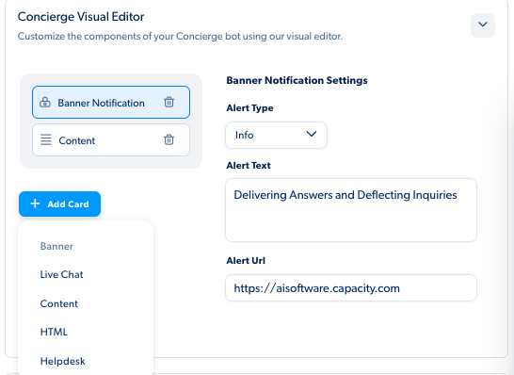
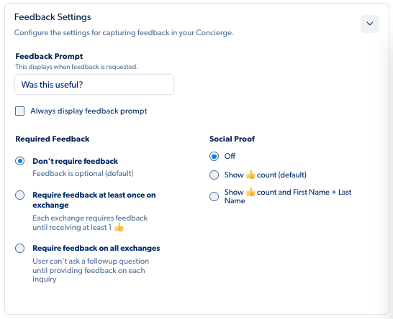
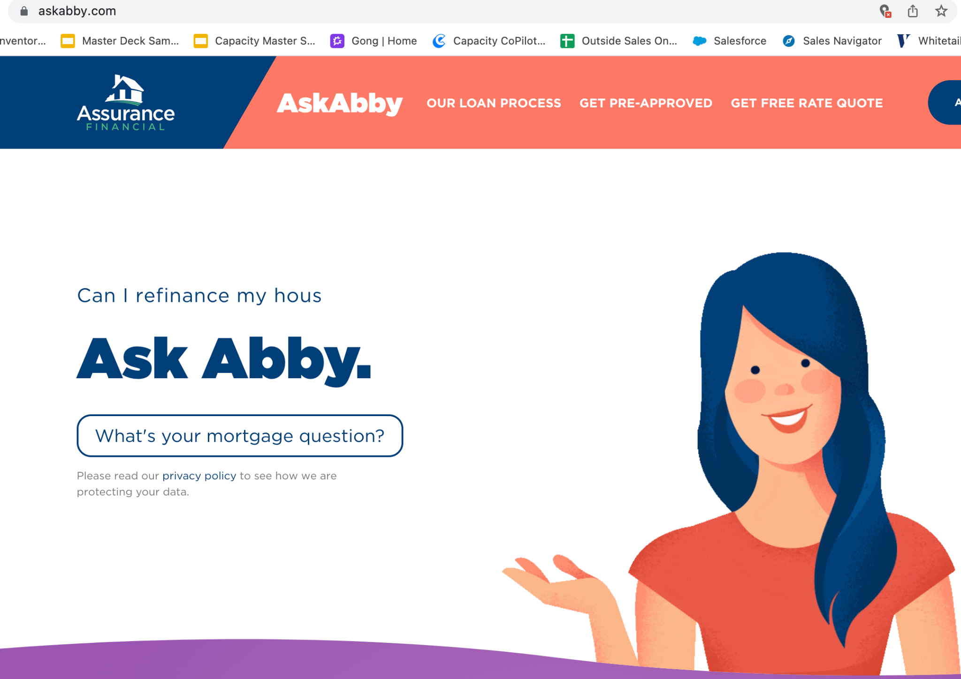
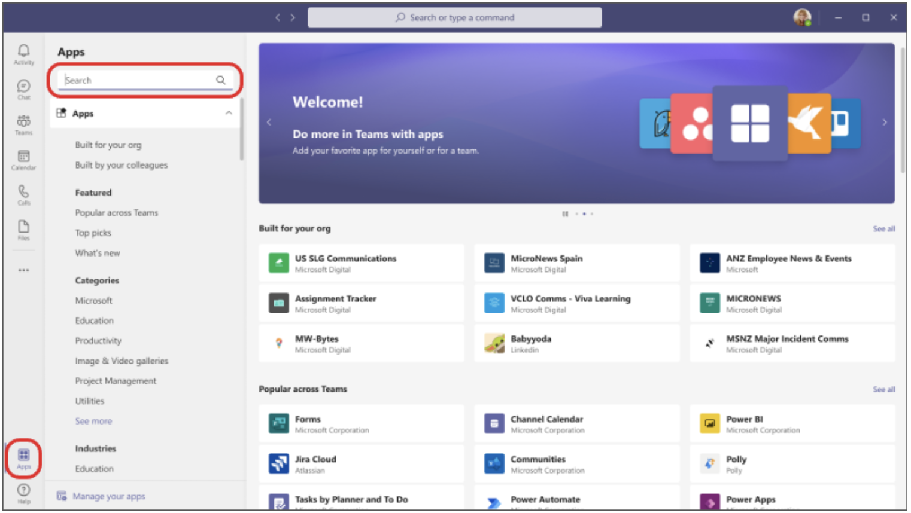
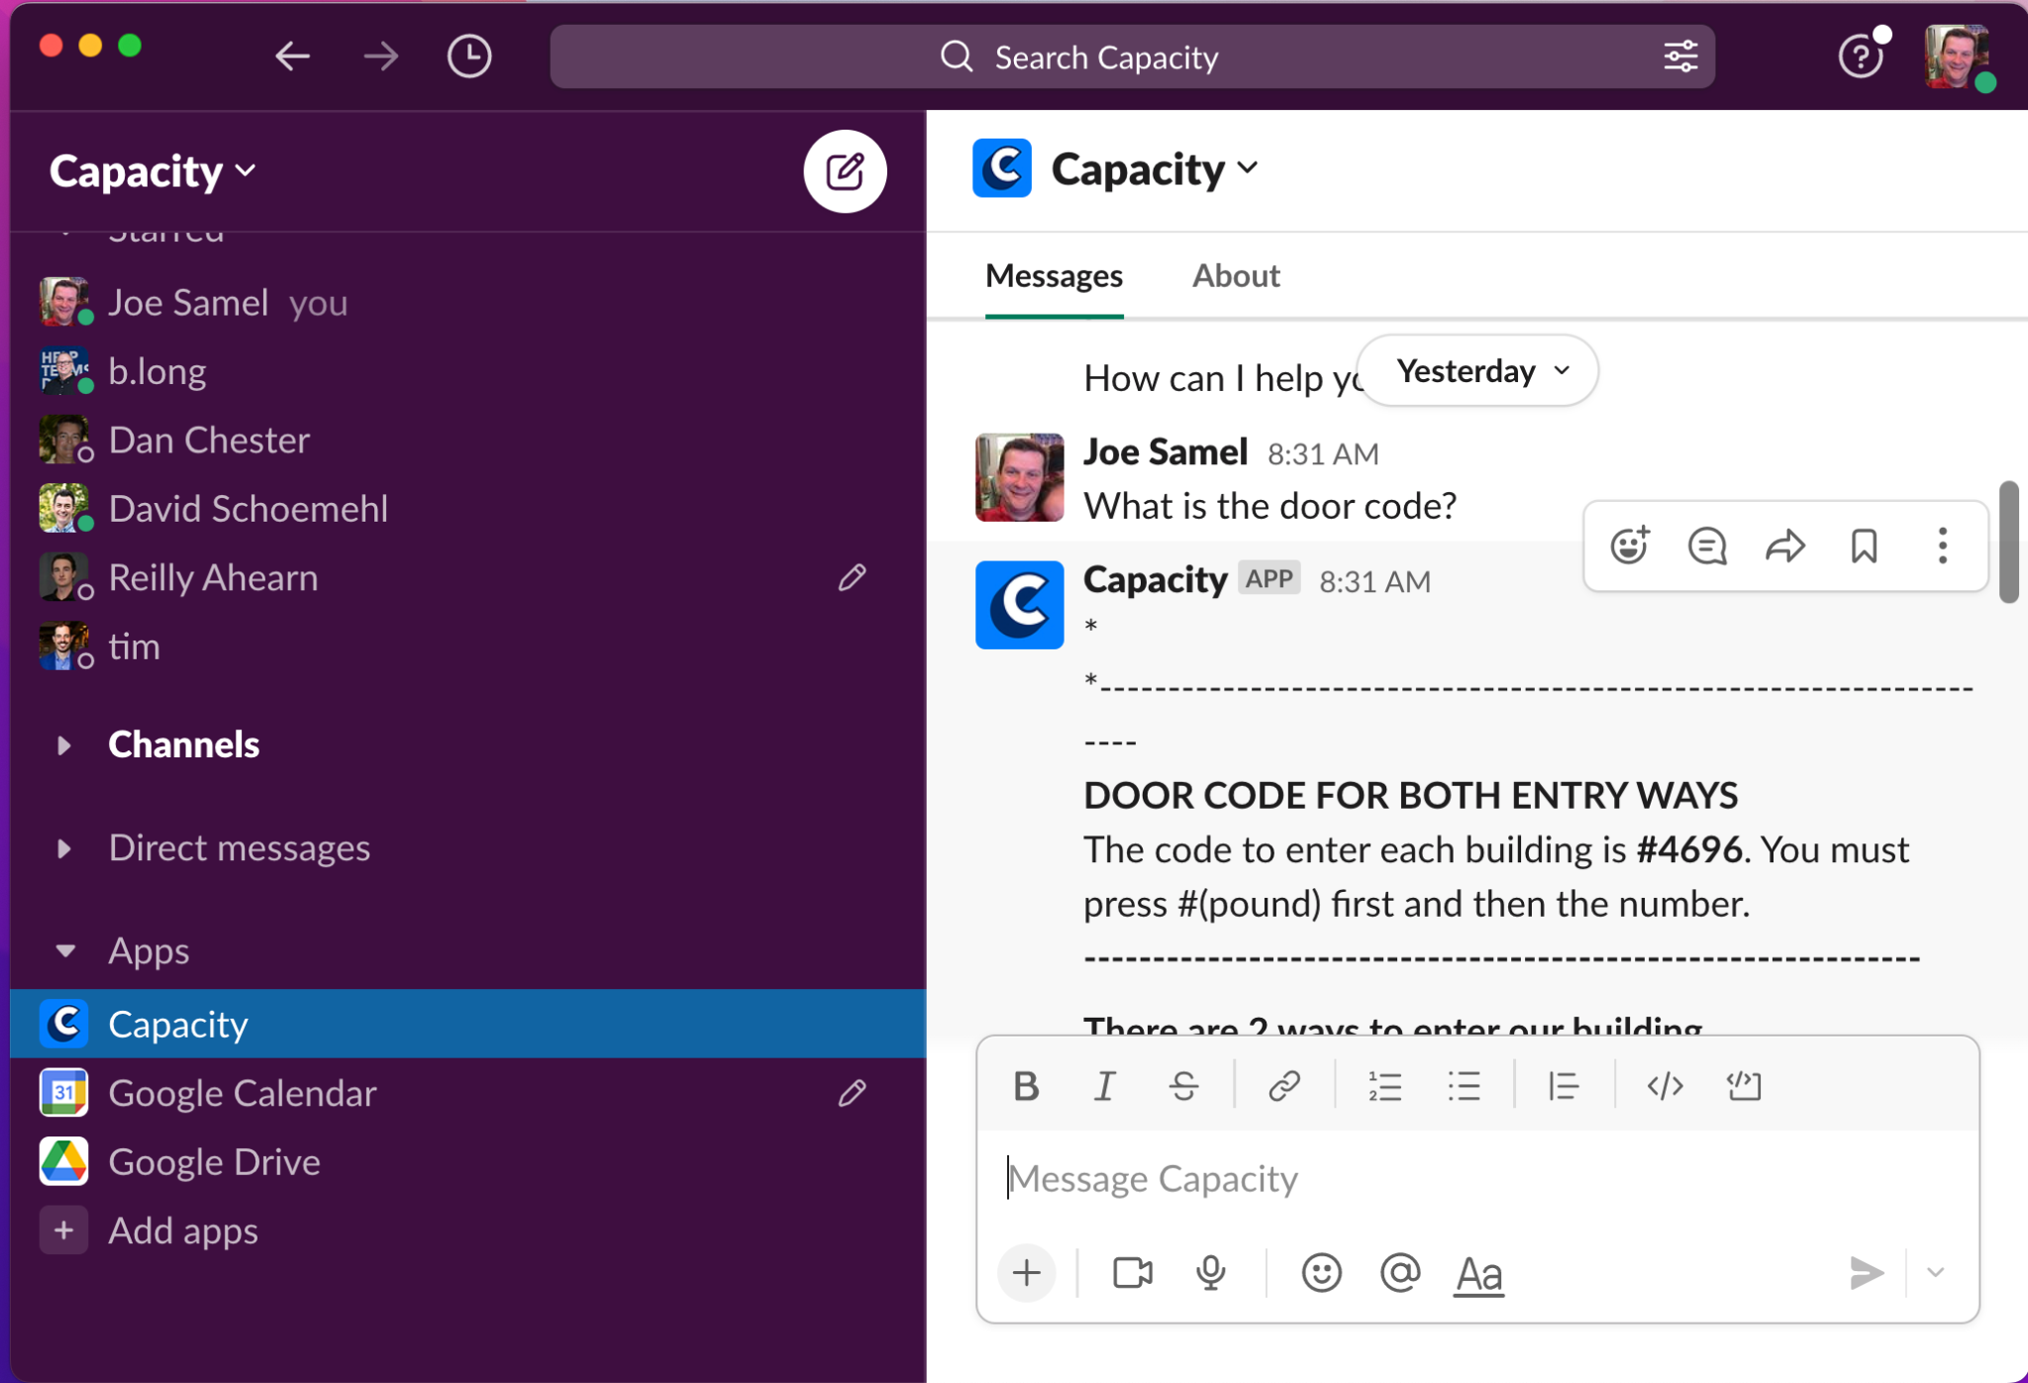

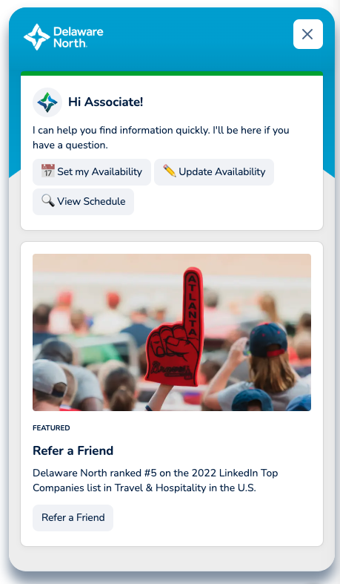
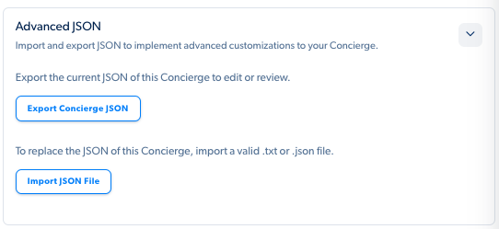
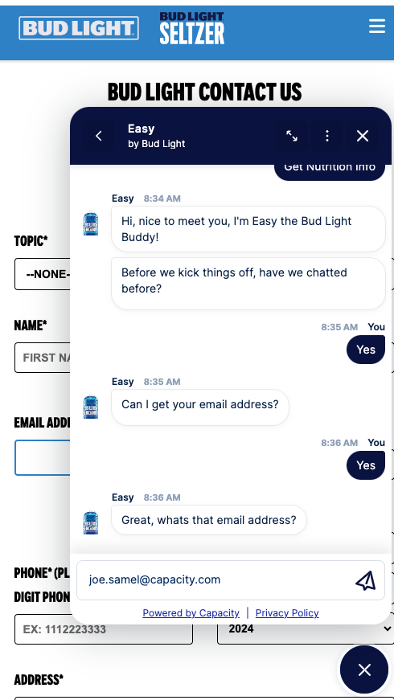
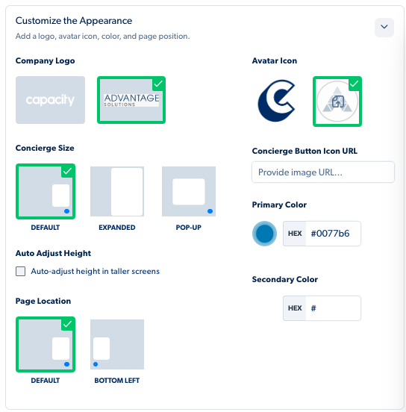
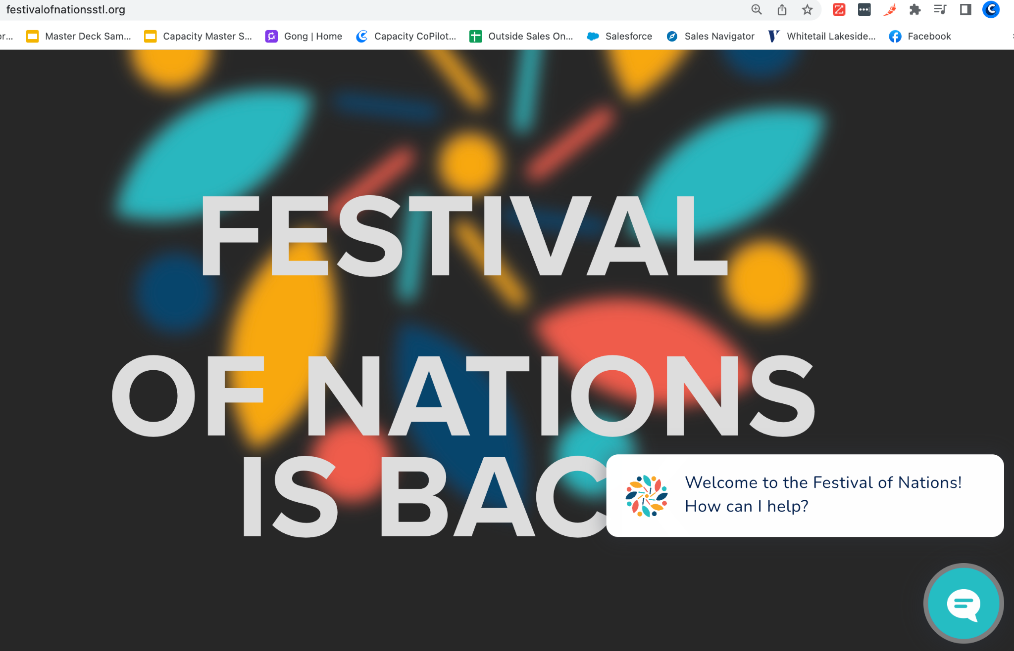
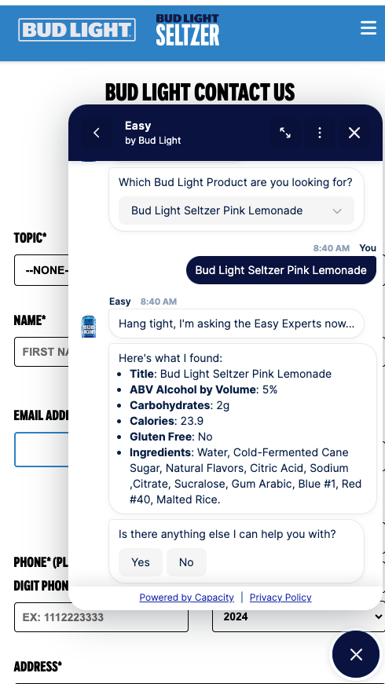
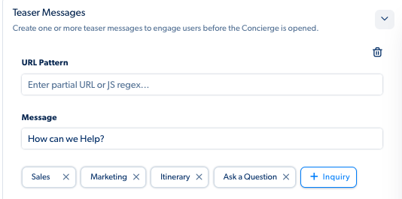
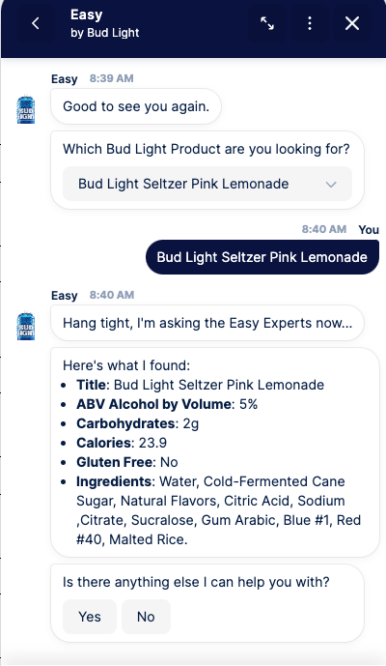
Customization Options: Flexibility of the platform in terms of Ai, customization, including branding, layout, and workflow.
Deployment and Design
Multiple Interfaces Available on single KB: Slack, Teams, Bot
Page and Time specific Triggers
Segmentation of Knowledge with
Varying features by application
Text and Live Chat integrated
Concierge Settings
Organizational Preference
Display and Universal rules
Privacy and Disclaimers
Clarifier & No Match Settings
Appearance and Branding
Teaser, Fallback and No Match
Bot Switcher Menu
Visual Editor
Advanced JSON
Age Gate
Survey Setting
Live Chat Hours and Fallback

Slide 6
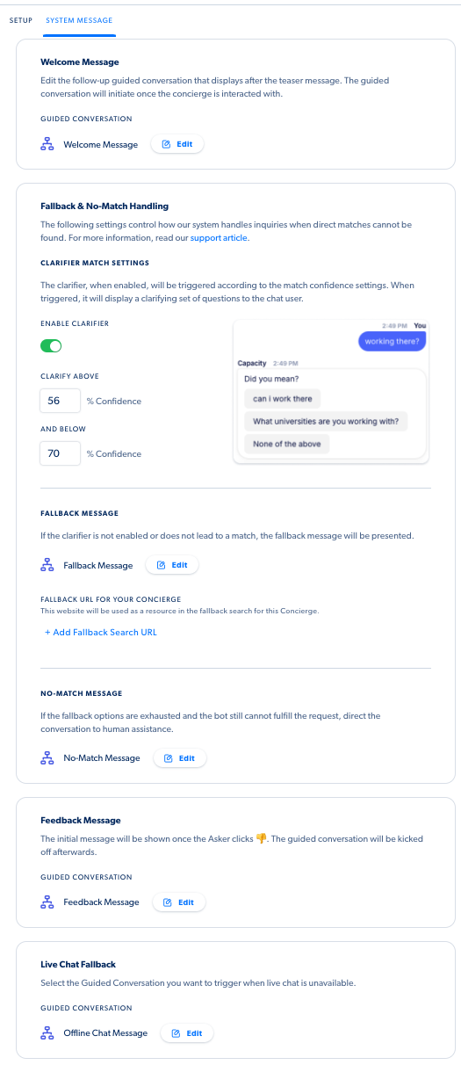
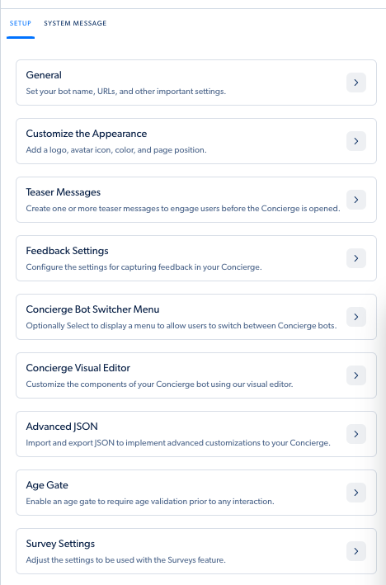
Customization Options: Flexibility of the platform in terms of Ai, customization, including branding, layout, and workflow.
Concierge Settings
Simple
Flexible
Parallel Structures

Slide 7
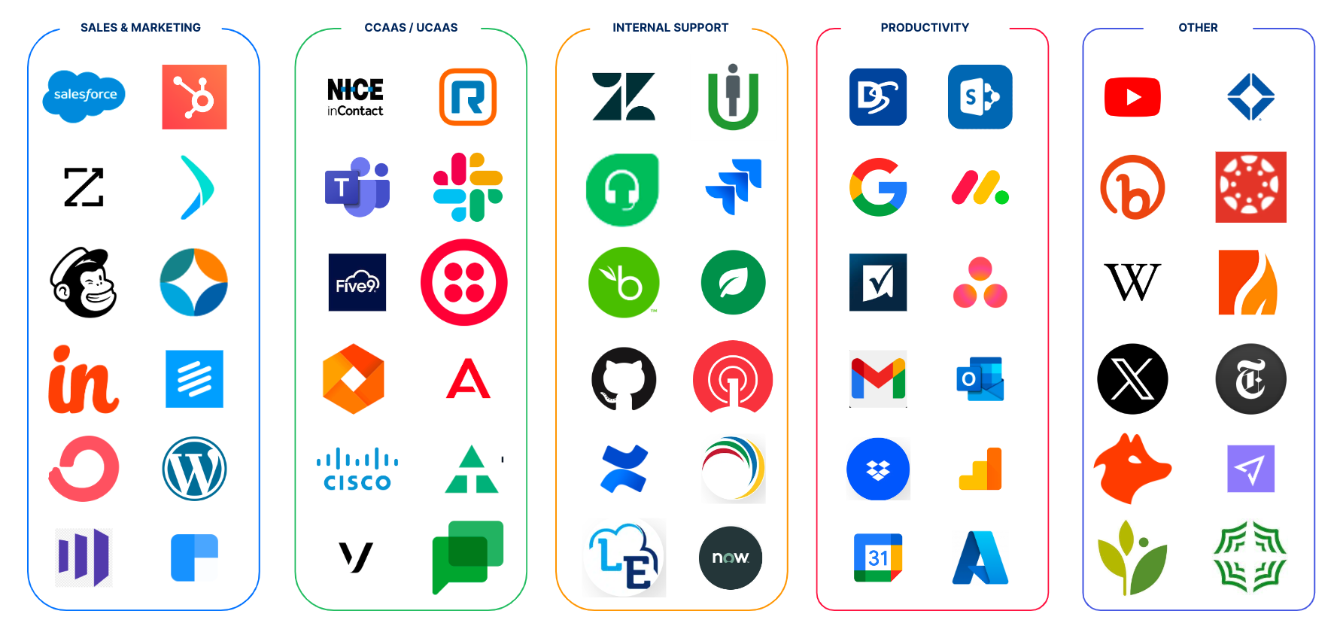
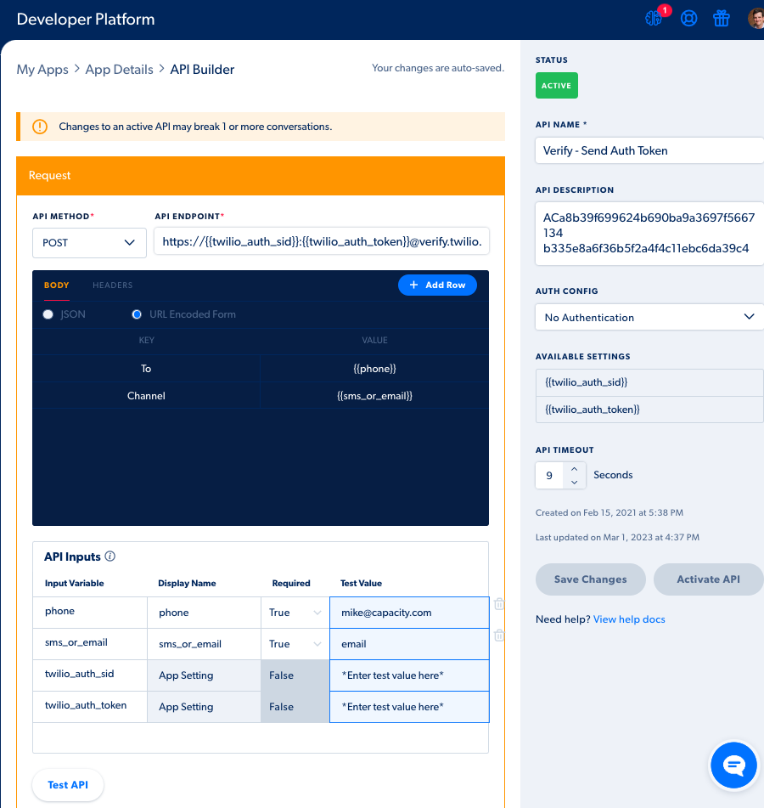


Integration Capabilities: How well the platform integrates with existing systems, such as CRM, helpdesk, or support services.
App Center
200+ App Integrations
Pre-Built connections: Sales, Marketing, CCASE/ UCASS, Customer & Agent Support, Helpdesk, Productivity, Sharepoint, BOX, etc..
Developer Platform
Connect to 3rd Party apps utilizing REST APIs
Manage service option as well as client data self-connection tool
Deliver Knowledge across the multiple interfaces
Connect with clean endpoint to live data into workflow, automations, GCs and the KB.

Slide 8
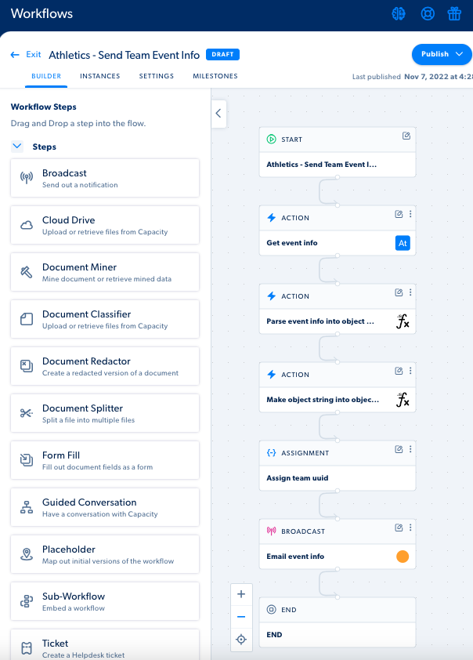
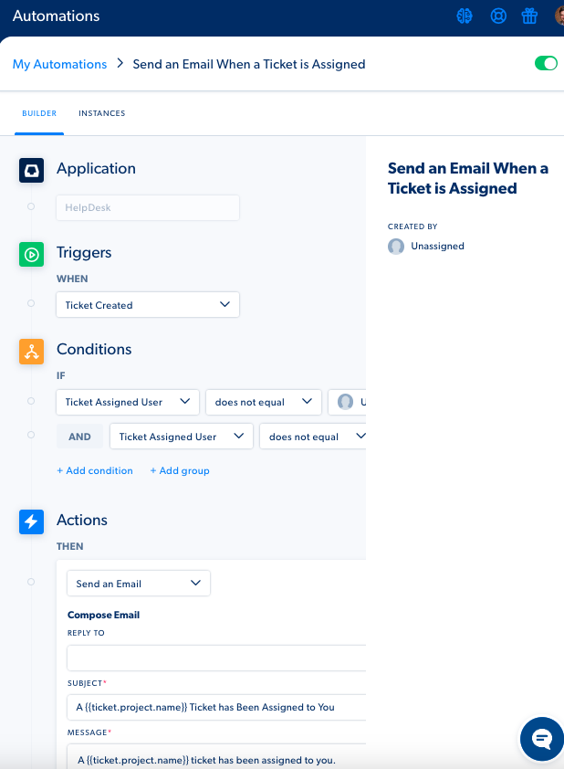
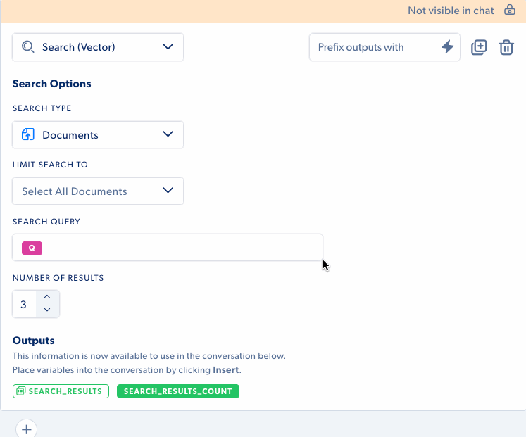
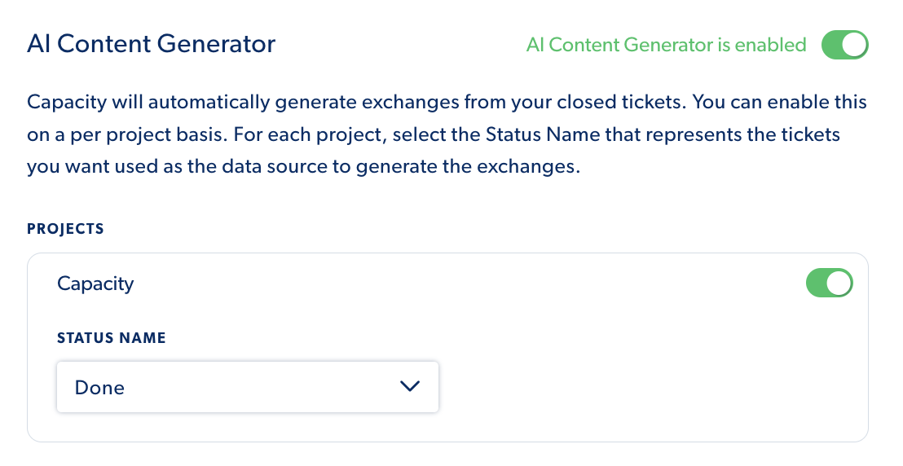
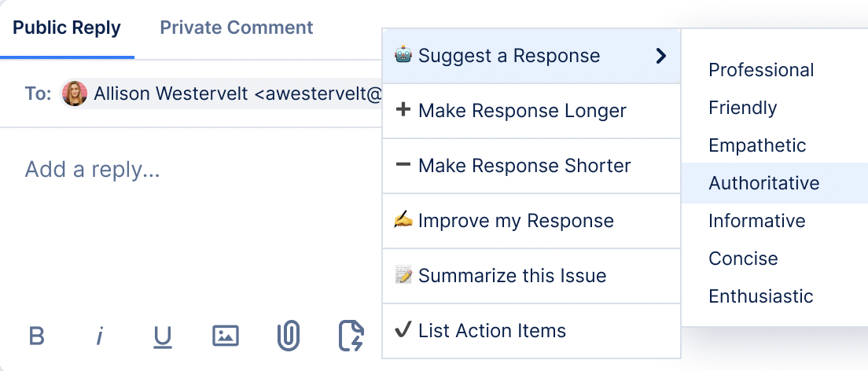
Customization Options: Flexibility of the platform in terms of Ai, customization, including branding, layout, and workflow.
Workflows and Automation
AI Setting and Features
Ai Assistant Card:
Multiple AI models, HIPAA Compliant, Out-of-the-box Prompt, Custom Prompts
Agent Autopilot
Automatically builds AI-generated answers from your PDF’s, Exchanges, Websites or Capacity Articles
Drive Indexing, Vector Search and External Site Search
Content Generator
Creates knowledge mining existing conversations and closed tickets
Agent ToolKit to apply
Version controls
Drop and Drag Features
Triggers and Actions
Error Guidance
Duplication
Traditional Retail Templates

Slide 9
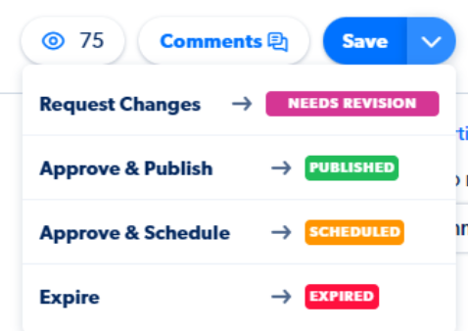
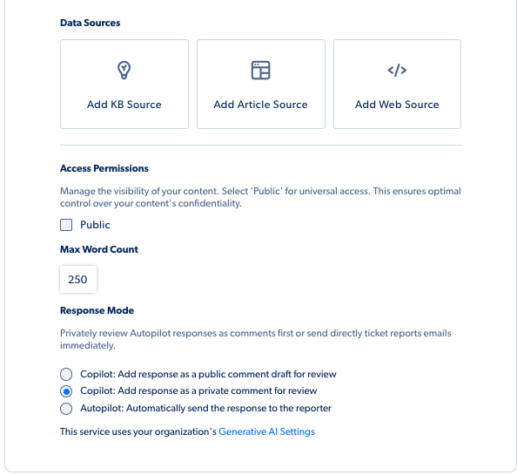
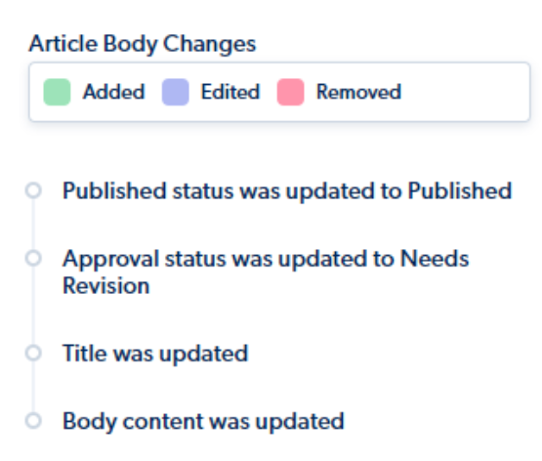
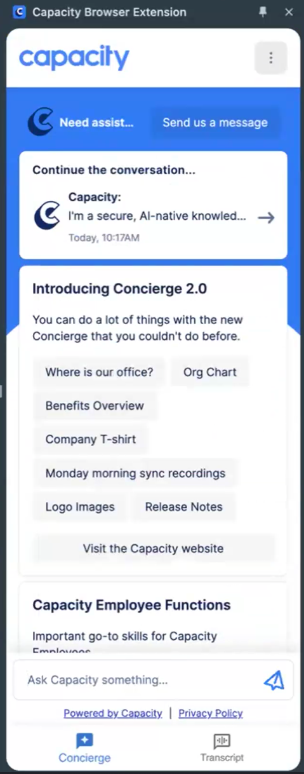
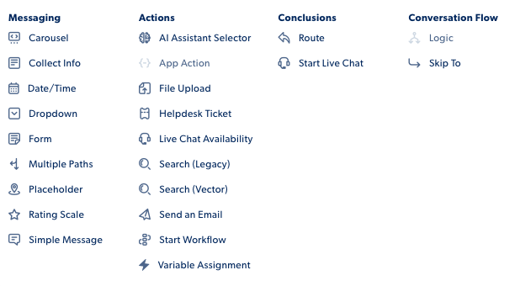
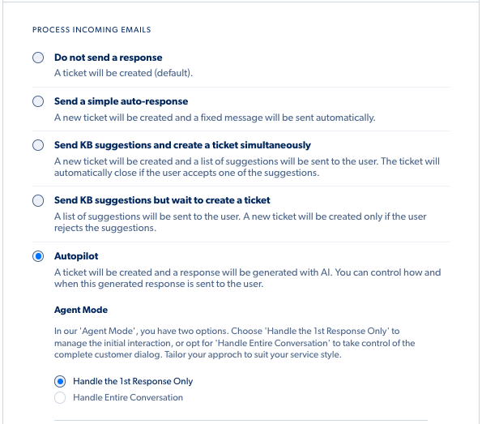
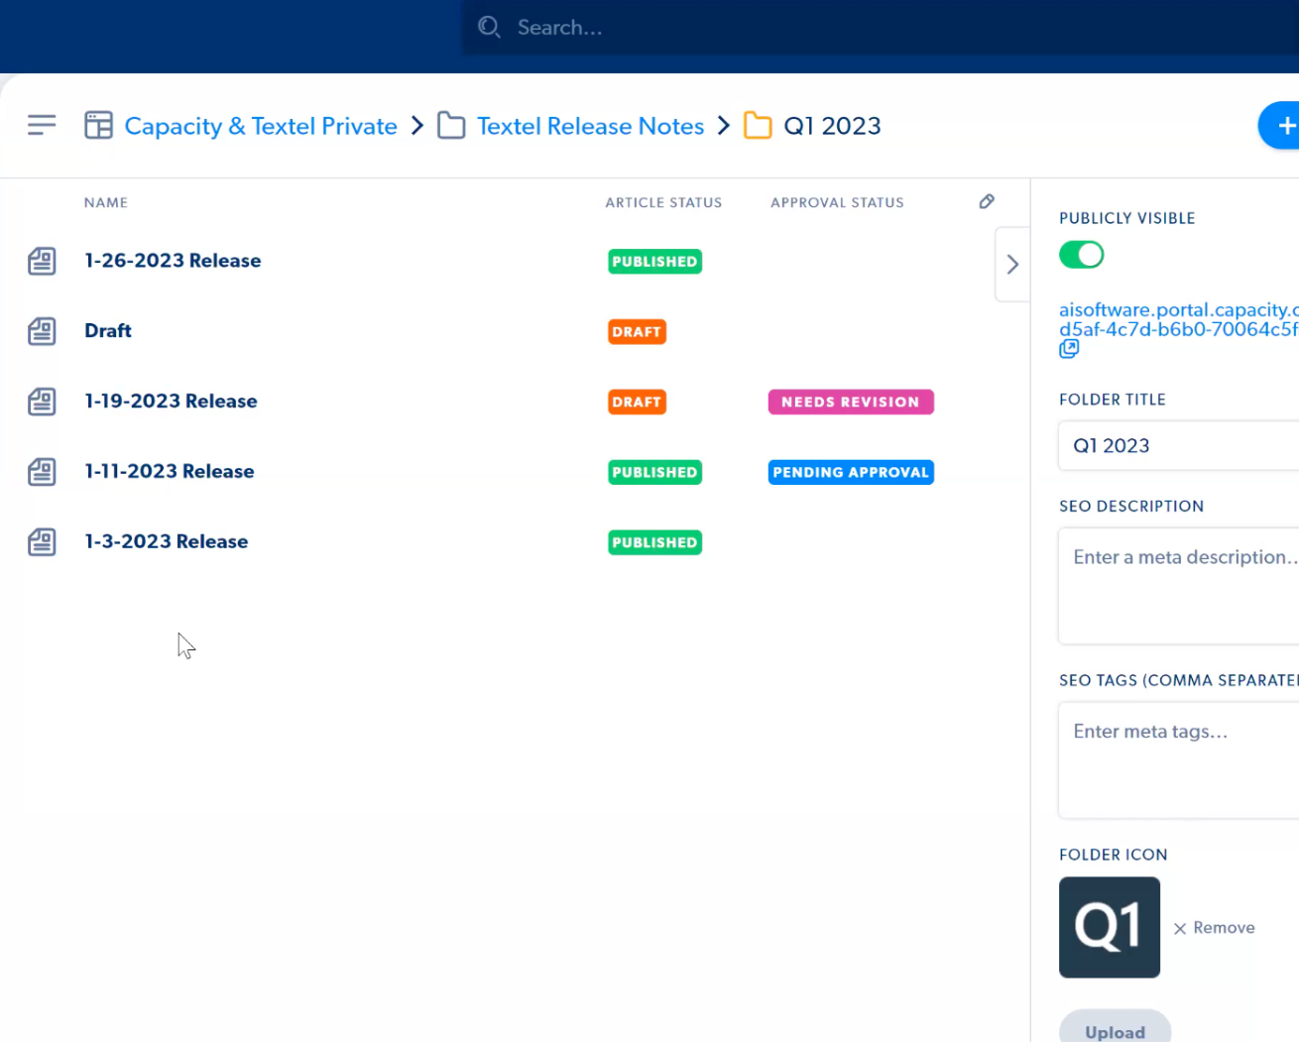
User Interface (UI): Usability and intuitiveness of the platform's interface for both administrators and end-users. Content Management Ease: Summarizing how easy it is to create, edit, and organize knowledge base articles and other content types within your platform.
Platform Framework
Customization and Settings
Conversation and Workflow Editors
Cascading Permissions
Low Code / No Code
Drop and Drag / Intuitive
Expanding Features
Strong Product Support
In-App AI assistance
Available Support Team
Dedicated Account Mgr.
Create Knowledge & Apply Settings
Vector Search & Drive Indexing
Additional Source Selections
Customized Prompts
AI composition and Draft
Escalation Rules and Logic
Knowledge Articles
Approval, History and Version settings, Actions and Status
Content Version Details
SEO & Meta Data settings
Attribution

Slide 10
Demo

Slide 11
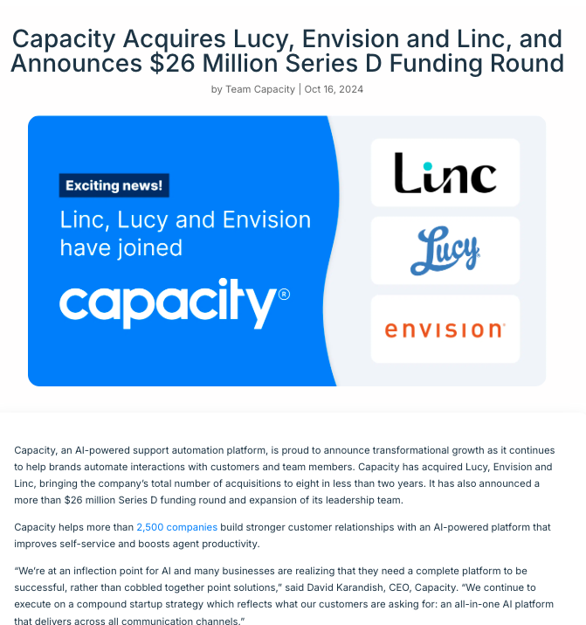
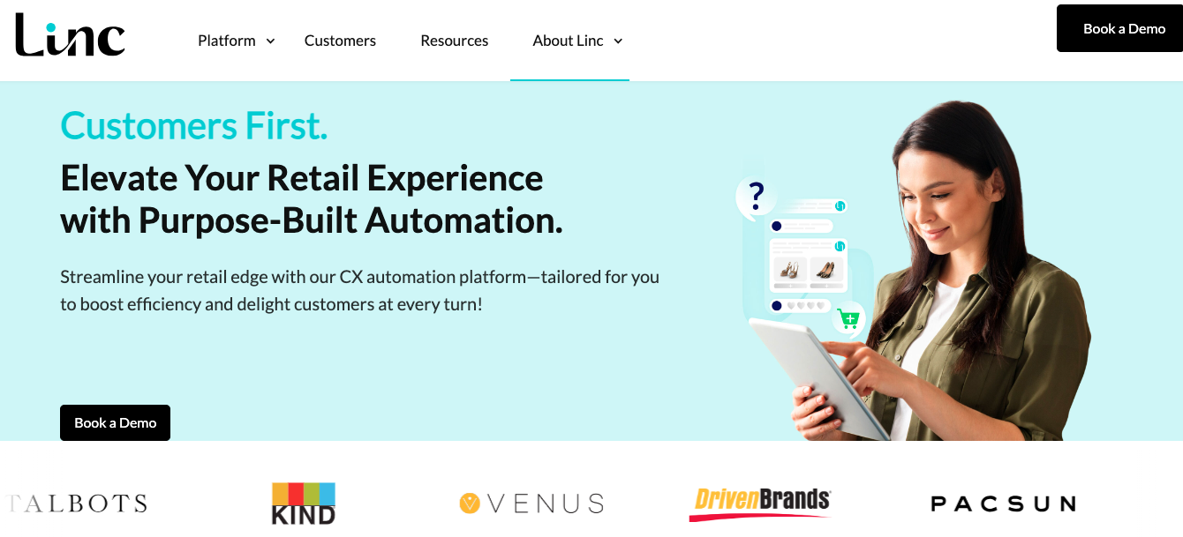
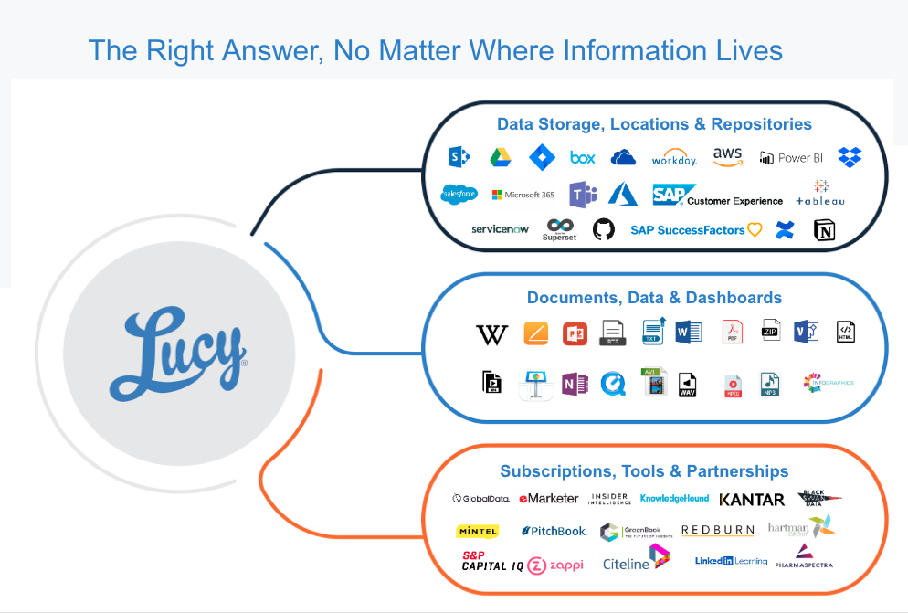
Growing Capacity
Incorporating Retail Bot Expertise
Expanded RAG and Integrations
Oct. 16, 2024

Slide 12



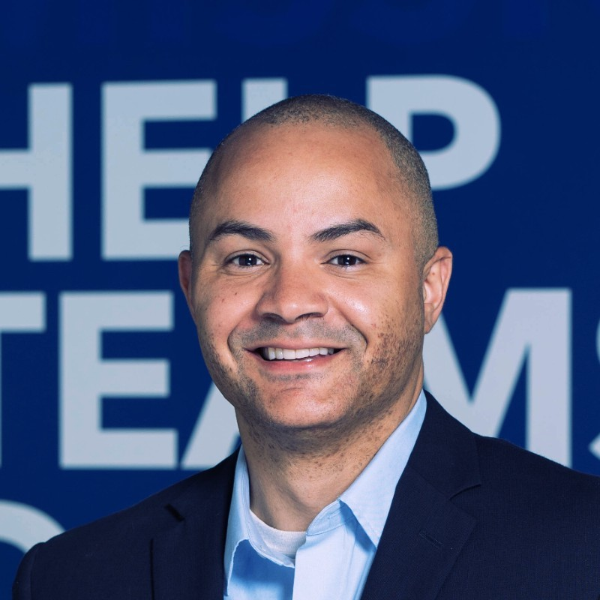





Leadership Team
David Karandish | Founder & CEO
Serial entrepreneur with 20+ years in tech
Grew previous startup from $0 to $960M exit
First outside capital at Nerdy (NYSE: NRDY)
Kathryn Love | VP & General Counsel
25+ years experience with Bryan Cave
Focus on corporate matters, risk management, contracts and M&A
Marcus Alexander | CFO
25+ years in F&A at Big 4 firms Deloitte and EY, public company Aegion (NASDAQ: AEGN) & high growth tech companies at Answers and Capacity
CPA, MBA
Mike Hunigan | VP of Ai
20+ years of Product experience in e-commerce, online publishing and enterprise software
Mike spent 10 years at Answers including 3 years within the ForeSee division
Tim Yeadon | COO
20+ years in sales and client success roles
10 years at Maryville Technologies and CA Technologies focused on the Support Automation product space
Bob Benedict | VP of Engineering
30+ years software development experience
Focus areas SaaS, e-learning, early stage companies
Management experience from Intuit, Adobe
Karaline Venezia | CRO
20+ years in sales and commercial leadership roles
Focus on Customer Experience, Contact Center and AI/Automation technology
Sammie Stephens | SVP of CS
10+ years in customer-facing positions in tech industry
Experience in customer support and account management

